Slide 1

In Vino Dolus
Brandon Miller
Charlie Handrick
Qi Chen

Slide 2

Introduction
Objective:
Fit first and second order Markov chains using the collection of real wine reviews.
Create a function that generates authentic fake wine reviews with fitted Markov chain methods.
Add more features to the designed function and explore future prospects.

Slide 3
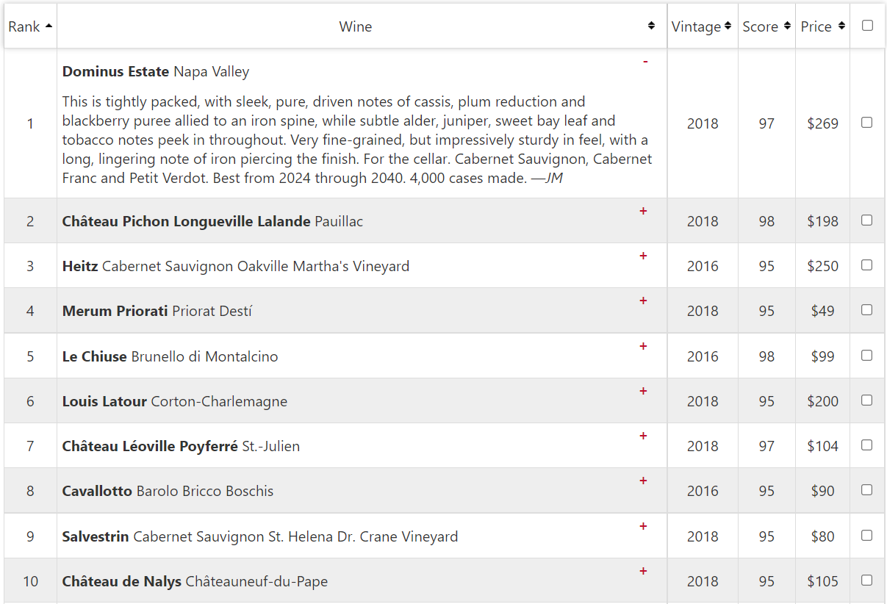
Data
Source: https://top100.winespectator.com/lists/

Slide 4
Data cleaning
Read in URL and grabbed table node
Mindful of punctuation
Separate best dates to drink, cases made, initials of reviewer, etc.

Slide 5
First Order Markov Chain
Markov chain:
A mathematical system that experiences transitions from one state to another according to certain probabilistic rules.
The defining characteristic of a Markov chain is that no matter how the process arrived at its present state, the possible future states are fixed.
First Order (Single word) :
Each next state depends only on the immediately preceding one.
- Markovchain R Package
- markovchainFit function
- markovchainSequence function

Slide 6
Second Order Markov Chain
Second Order (Bigram):
The processes in which the next state depends on two preceding ones.

Slide 7
Analyzing Best Reviews from Two Markov Chains
First-Order Markov Chain
THIS is delightful, with fine-grained tannins and lovely beam of tarry smoke...
THIS is crisp yet well-structured, but keeps focused and harmony elegantly layered with well-knit...
Second-Order Markov Chain
THIS IS ample yet the refined structure keeps this focused and balanced and multilayered with expressive mineral undertones...
THIS IS tightly packed with warm raspberry blackberry and black cherry fruit flavors that stay focused with mineral spice and roasted sage...

Slide 8
Analyzing Worst Reviews from Two Markov Chains
First-Order Markov Chain
THIS is already an iron piercing the finish this silky tannins minerally iron piercing the strident...
THIS is supple and round evoking macerated cherry plum and black licorice notes...
Second-Order Markov Chain
THIS IS power and red, strawberry enter on the end, yet restrained profile of cassis and fresh and tobacco...
THIS IS filled with blood orange, while subtle streak of ripe fruit and pomegranate flavors that carry hints...

Slide 9
Analyzing Funniest Reviews from Two Markov Chains
First-Order Markov Chain
THIS is pumping along nicely flanked by a second wave of steeped blackberry raspberry and spiced tea accents...
THIS has a smoky meat, crushed plum and grapefruit zest...
Second-Order Markov Chain
THIS IS a juicy bomb of fruit which is creamy midpalate with concentrated raspberry tart flavors...
THIS IS a nice power with consistent notes all glide e through the fruit-earth interplay showing admirable breadth and boysenberry flavors inlaid...

Slide 10

Sprucing Up the Functions
Adding additional outputs to the reviews
Vintage
Price
Score
Reasons:
Accuracy
Functionality
Overall More Realistic Reviews

Slide 11
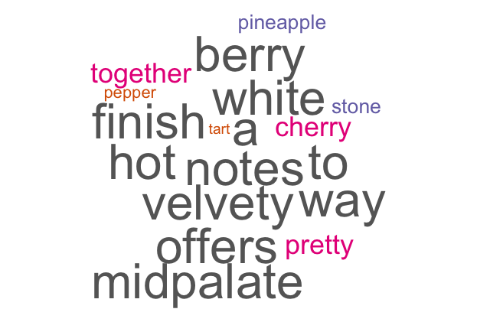
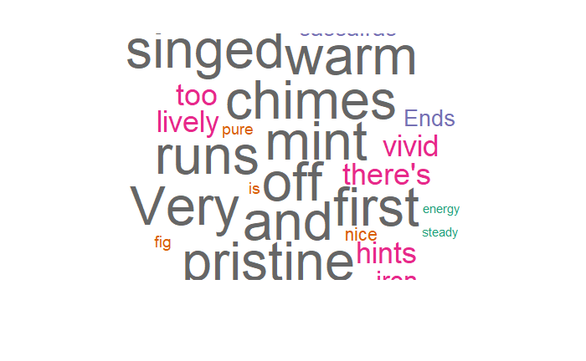
Additional Function Features
Cabernet
Pinot Noir

Slide 12

Application of Markov Chain Methods to Other Forms of Technology
Hidden Markov Model (HMM)
Takes into account for grammar in languages categorized as hidden events, focuses on probability of syllables/sounds following each other
Example: Siri
Machine Learning/ AI

Slide 13
Conclusion
The Markov chain method is simple and effective to create a predictive text model.
Relies on probabilities of words following each, not accounting for grammar or context of sentences
Can be applied as a predictive text model using single term and n-gram combinations

Slide 14
THANKS

